Slide 1
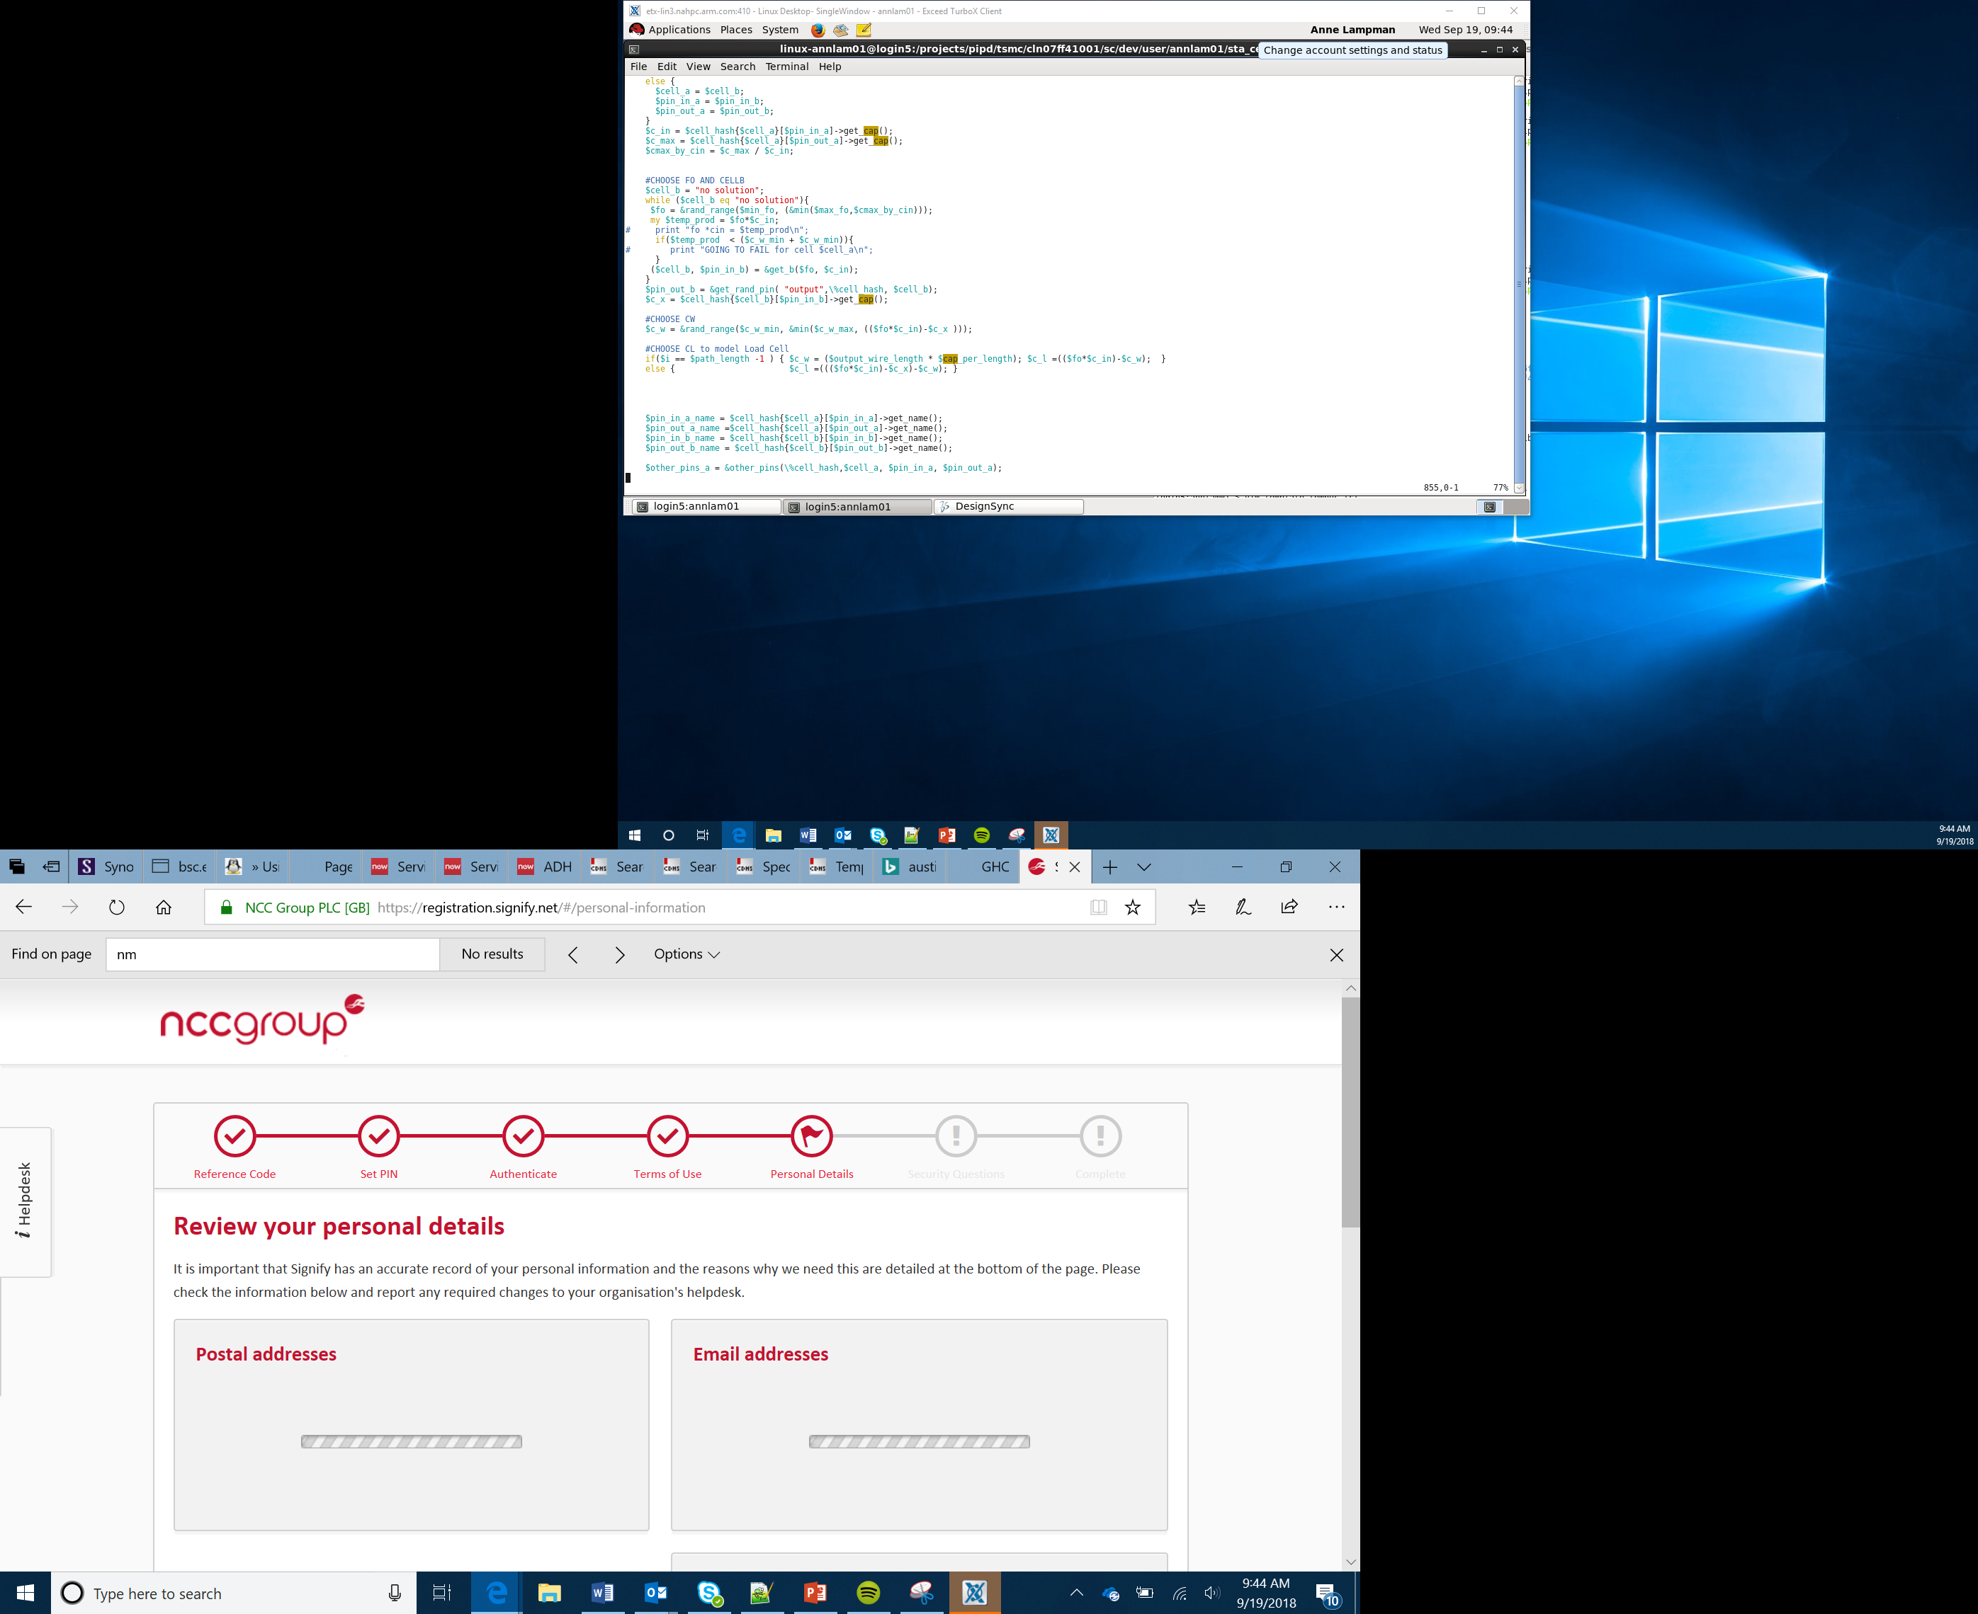

Outputs
Lesson 4

Slide 2
Objectives
Use code to produce an output
Be able to flash the LEDs and change colour
Identify motor changes for specific angles
Use code to enable and disable the buzzer

Slide 3
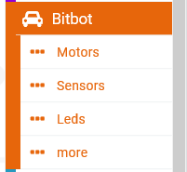
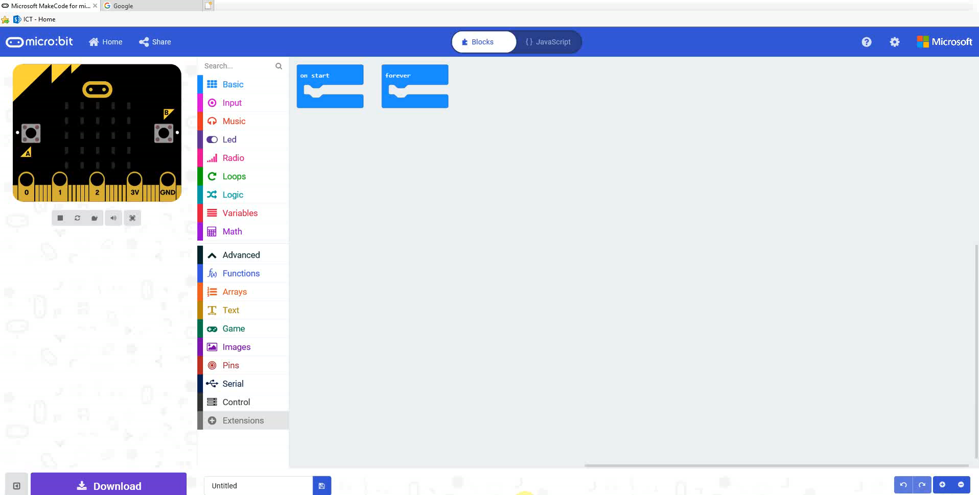
Using the Motors
Ensure you have the Bit:Bot Extensions added to the project
Notes:
Remind students how to add the Bit:Bot extension

Slide 4
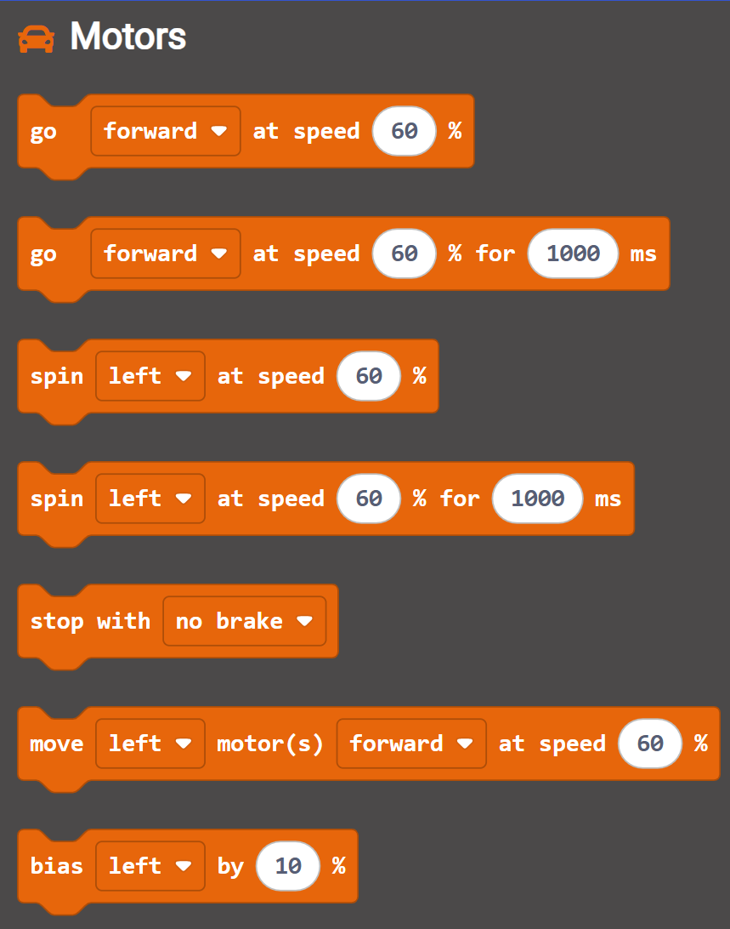
Using the Motors
Drive Motors
Drive Motor for given time
Spin Wheels
Spin Wheels for given time
Drive left or right motor
Spin drives the chosen wheel forward but the opposite in reverse
Notes:
Discuss the use of motors and how we can use these to propel the vehicle
Discuss the idea of driving both wheels and what the result of driving one wheel or wheels in opposite directions would be

Slide 5
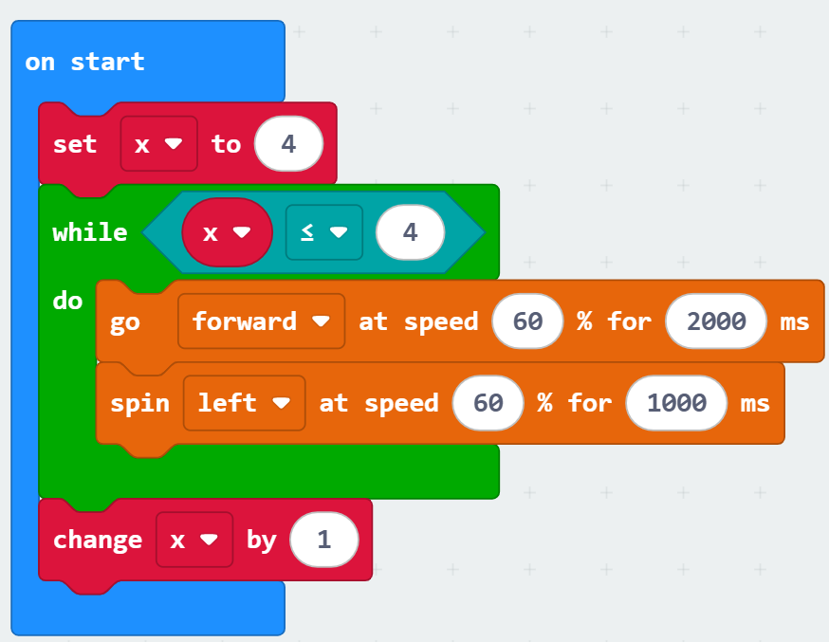
Using the Motors
Getting Started
Try the example right – predict what will happen
Try to drive the robot in a square and return to the starting point
Pro-tip
Spin drives one motor forward and one in reverse
Stretch Tasks
Try to drive the robot in a triangle or other polygon pattern
Notes:
Demonstrate how the motors are driven and give the students the opportunity to experiment

Slide 6
Using the LEDs
Normally changing LEDs is a two-stage process
Make the change
Show the change
The Bit:Bot is set to automatically update so any changes are applied without the need to update
Notes:
Explain how programmable LEDs can show a range of colours by being able to mix RGB light
Demonstrate how to turn on and off LEDs and to rotate the position of which LEDs are on
Ensure students get the opportunity to experiment, especially with speed of change.

Slide 7
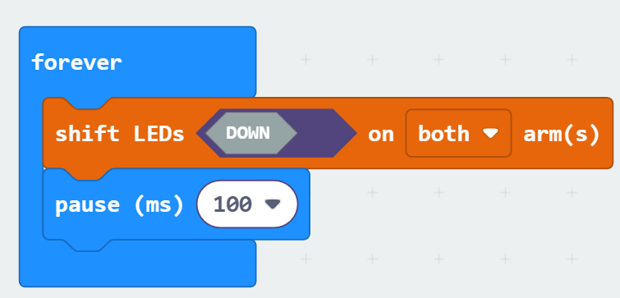
Using the LEDs
Getting Started
Try the example on the left
Pro-tip
Shift moves one step, rotate keeps going around
Stretch Task
Start on the first LED and move it round one place to the end of the row
Final Thoughts
How fast can the lights change? What is the lowest practical delay to use?

Slide 8
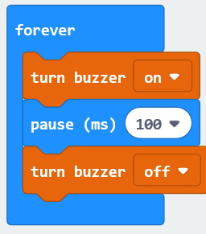
Using the Buzzer
The buzzer can be enabled and disabled in the buzzer block
Use the pause block to keep it ‘on’ or ‘off’ for a given time
Notes:
Demonstrate how to turn on and off the buzzer

